Slide 1
Constructing scatter graphs by utilising technology
Graphical representations of data

Slide 2
how to use Oak lessons

Slide 3
I can construct scatter graphs from data presented in a number of different ways using technology.

Slide 4
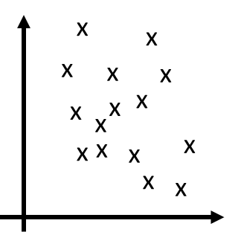
A scatter graph is a visual representation for bivariate data. It can be useful when determining the nature of the relationship between the two variables.

Slide 5

Constructing scatter graphs by utilising technology
Constructing a scatter graph using a spreadsheet
Constructing scatter graphs using Desmos

Slide 6
Constructing a scatter graph using a spreadsheet
Scatter graphs tend to be more useful when dealing large amounts of data than when dealing with small amounts of data.
Constructing scatter graphs by hand can be a slow process.
Scatter graphs plotted by hand can also be inaccurate.
It can be impractical to plot a scatter graph by hand for large amounts of data.
Technology can be a useful way to plot scatter graphs quickly and accurately.

Slide 7
Constructing a scatter graph using a spreadsheet
Spreadsheet software can plot scatter graphs quickly and accurately.
Examples of spreadsheet software include Google Sheets, Microsoft Excel and Apple Numbers. But there are others.
While the demonstrations in this lesson use Google Sheets, other software usually have the same functions. However, the buttons might be in different places.

Slide 8
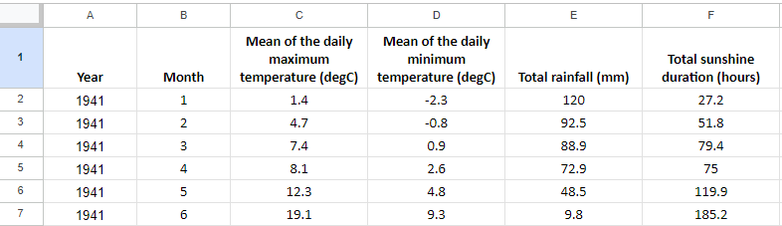
Constructing a scatter graph using a spreadsheet
This lesson will explore a large dataset from The Met Office, about weather in Bradford from 1941 to 2022.
Access the data by clicking here: Bradford weather data🖇
Google Sheets is a trademark of Google LLC and this content is not endorsed by or affiliated with Google in any way.

Slide 9
Constructing a scatter graph using a spreadsheet
This lesson will explore a large dataset from The Met Office, about weather in Bradford from 1941 to 2022.
The first two columns show the year and month for each row of data.
Google Sheets is a trademark of Google LLC and this content is not endorsed by or affiliated with Google in any way.

Slide 10
Constructing a scatter graph using a spreadsheet
This lesson will explore a large dataset from The Met Office, about weather in Bradford from 1941 to 2022.
The maximum temperature (℃) for each day was recorded. This column shows the mean for each month.
Google Sheets is a trademark of Google LLC and this content is not endorsed by or affiliated with Google in any way.

Slide 11
Constructing a scatter graph using a spreadsheet
This lesson will explore a large dataset from The Met Office, about weather in Bradford from 1941 to 2022.
The minimum temperature (℃) for each day was recorded. This column shows the mean for each month.
Google Sheets is a trademark of Google LLC and this content is not endorsed by or affiliated with Google in any way.

Slide 12
Constructing a scatter graph using a spreadsheet
This lesson will explore a large dataset from The Met Office, about weather in Bradford from 1941 to 2022.
This column shows the total amount of rainfall for the entire of each month.
Google Sheets is a trademark of Google LLC and this content is not endorsed by or affiliated with Google in any way.

Slide 13
Constructing a scatter graph using a spreadsheet
This lesson will explore a large dataset from The Met Office, about weather in Bradford from 1941 to 2022.
This column shows the total number of hours of visible sunshine for each month.
Google Sheets is a trademark of Google LLC and this content is not endorsed by or affiliated with Google in any way.

Slide 14
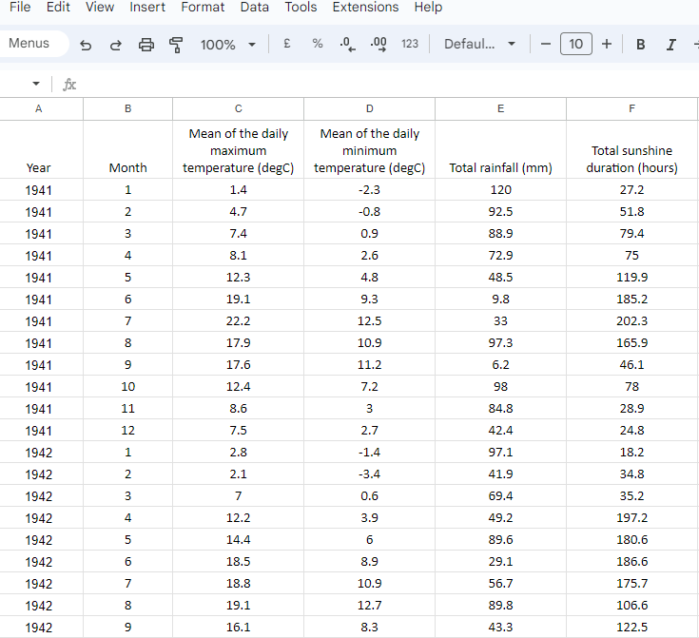
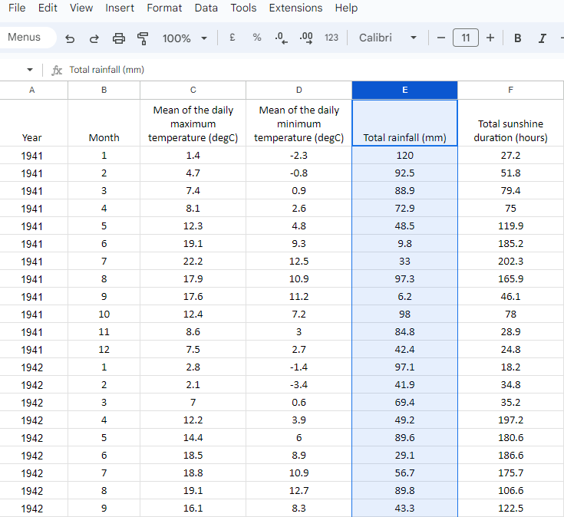
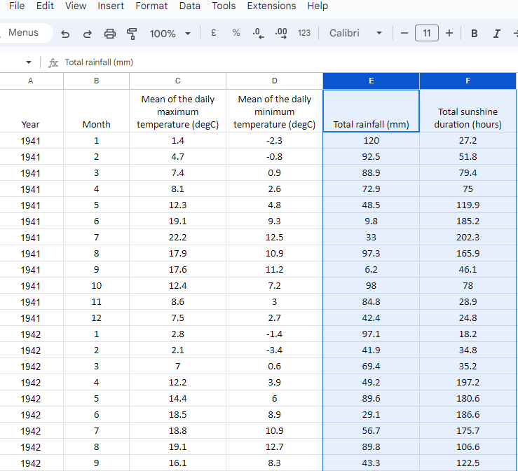
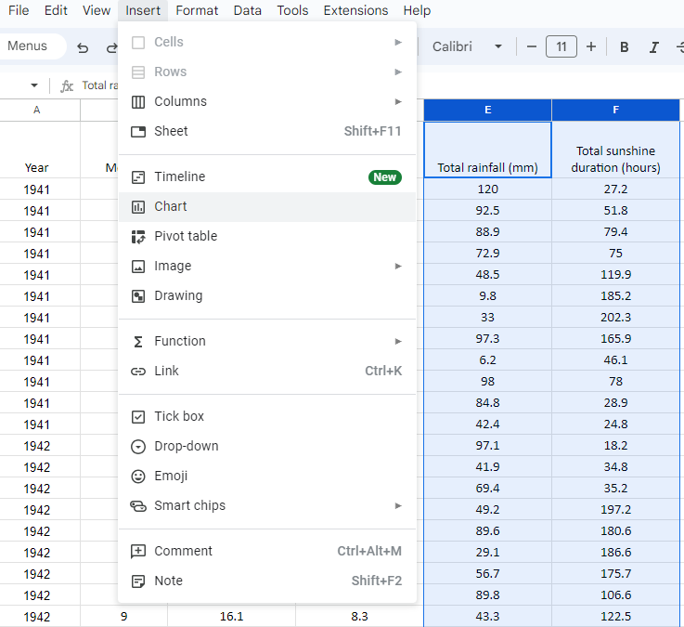
Constructing a scatter graph using a spreadsheet
Plot a scatter graph to represent total rainfall and total sunshine hours.
To select the data we are using:
click the E column heading
hold the ctrl key
click the F column heading
To insert a scatter graph:
click insert and chart
Google Sheets is a trademark of Google LLC and this content is not endorsed by or affiliated with Google in any way.

Slide 15
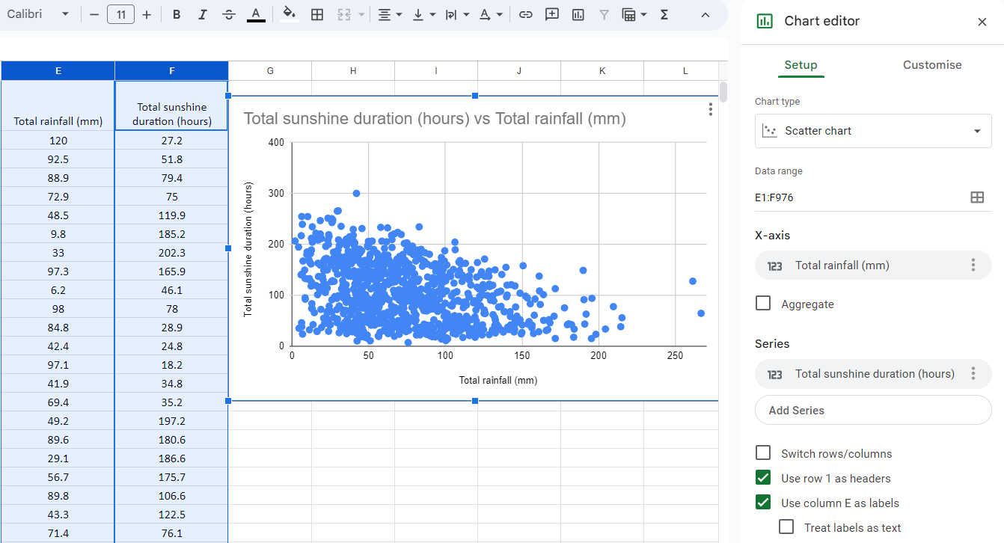
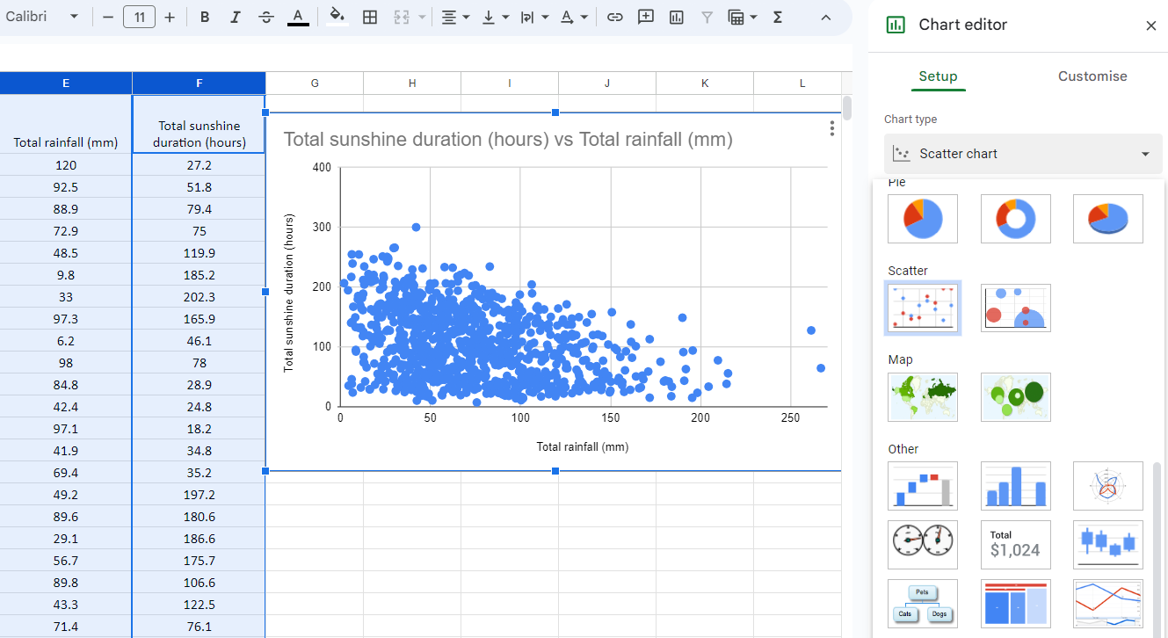
Constructing a scatter graph using a spreadsheet
It may automatically choose to plot a scatter graph for you.
If not, you can select scatter graph by clicking chart type and selecting scatter.
Google Sheets is a trademark of Google LLC and this content is not endorsed by or affiliated with Google in any way.

Slide 16
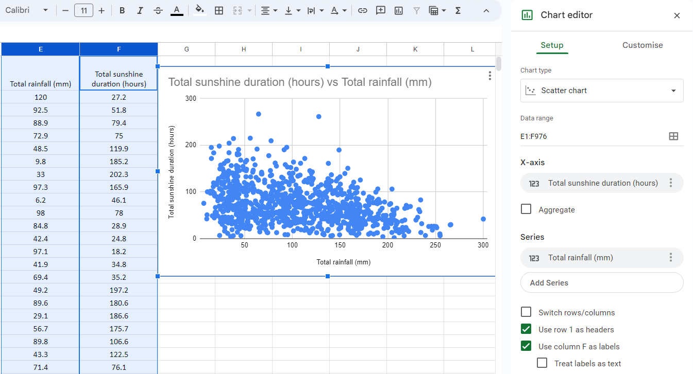

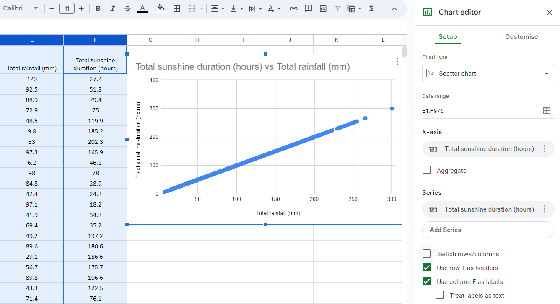
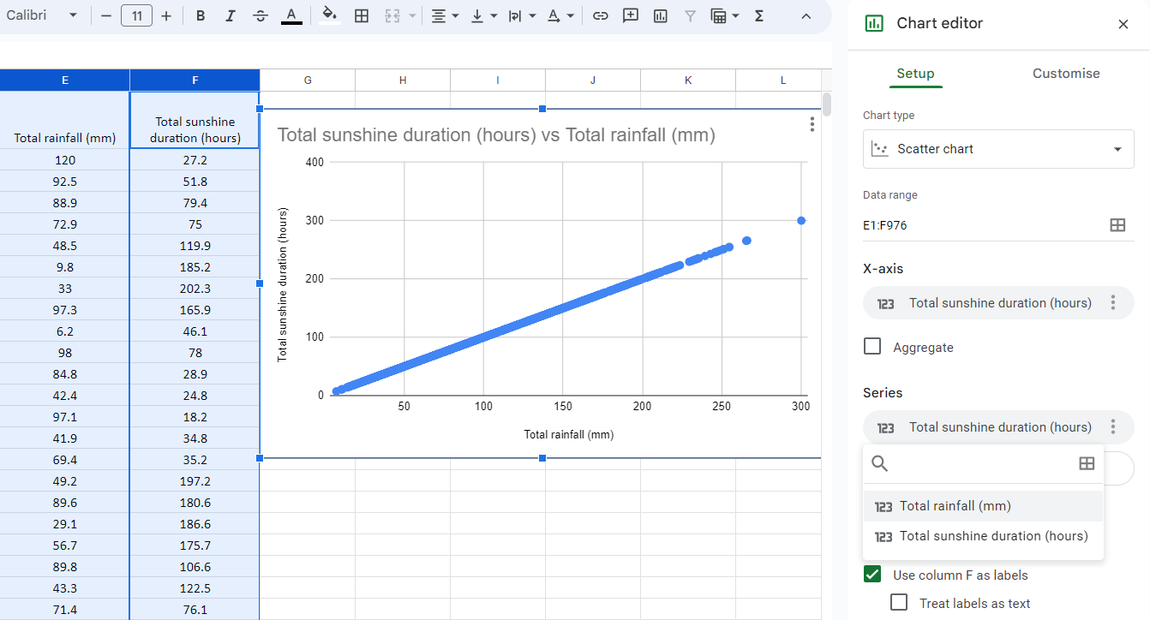
Constructing a scatter graph using a spreadsheet
In this example, the software has chosen rainfall for the horizontal axis and sunshine for the vertical axis.
To switch the axis:
click x-axis for the horizontal axis
click total sunshine duration
click series for the vertical axis
click total rainfall
Google Sheets is a trademark of Google LLC and this content is not endorsed by or affiliated with Google in any way.

Slide 17
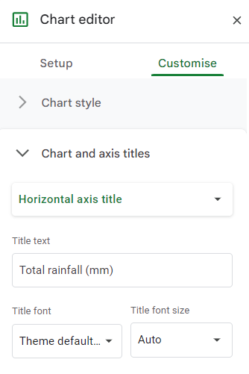
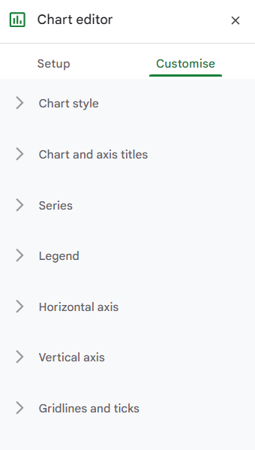
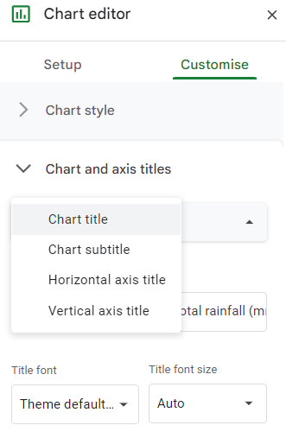
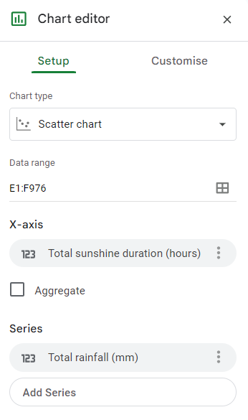
Constructing a scatter graph using a spreadsheet
In this example, the software has labelled the axis automatically.
To change the labels on the axis:
click customise
click chart and axis titles
for title type selector, click horizontal axis title
type the axis title here
repeat for the vertical axis
Google Sheets is a trademark of Google LLC and this content is not endorsed by or affiliated with Google in any way.

Slide 18
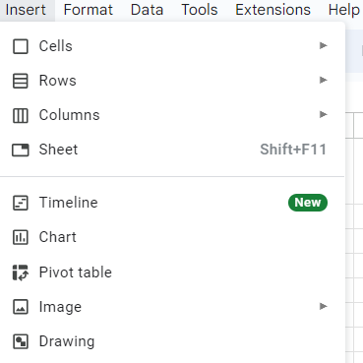

Constructing a scatter graph using a spreadsheet
Which option do you click to insert a scatter graph?
sheet
chart
image
drawing
Google Sheets is a trademark of Google LLC and this content is not endorsed by or affiliated with Google in any way.

Slide 19
Constructing a scatter graph using a spreadsheet
What do you click to choose a variable for the horizontal axis?
chart type
x-axis
series
switch rows/columns
Google Sheets is a trademark of Google LLC and this content is not endorsed by or affiliated with Google in any way.

Slide 20
Constructing a scatter graph using a spreadsheet
What do you click to choose a variable for the vertical axis?
chart type
x-axis
series
switch rows/columns
Google Sheets is a trademark of Google LLC and this content is not endorsed by or affiliated with Google in any way.

Slide 21
Constructing a scatter graph using a spreadsheet
1) Access the data for this task by clicking here: Bradford weather data 🖇
Construct a scatter graph with the horizontal axis showing total rainfall and the vertical axis showing mean daily minimum temperature.
Google Sheets is a trademark of Google LLC and this content is not endorsed by or affiliated with Google in any way.

Slide 22
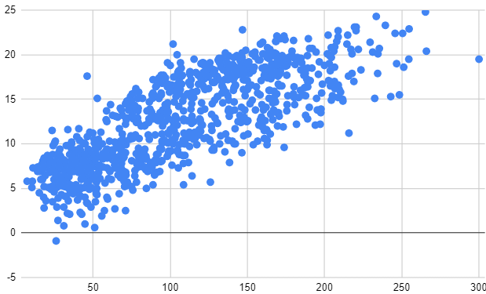
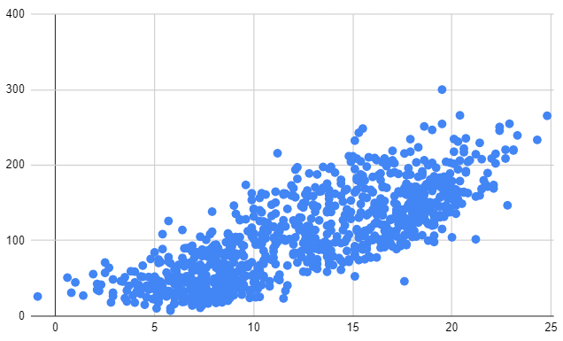
Constructing a scatter graph using a spreadsheet
2) The scatter graphs below were plotting using the same dataset as Q1. Access the data for this task by clicking here: Bradford weather data. 🖇
Plot different scatter graphs to work out which variables go on the horizontal axis in each of the graphs below.
mean maximum daily temperature (℃)
total sunshine duration (hours)
Google Sheets is a trademark of Google LLC and this content is not endorsed by or affiliated with Google in any way.

Slide 23
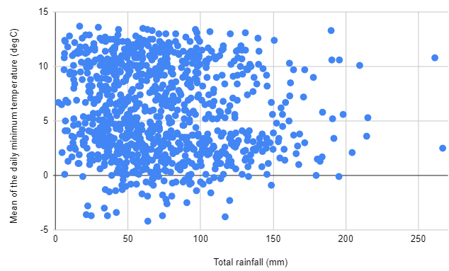
Constructing a scatter graph using a spreadsheet
1) Access the data for this task by clicking here: Bradford weather data 🖇
Construct a scatter graph with the horizontal axis showing total rainfall and the vertical axis showing mean daily minimum temperature.
Google Sheets is a trademark of Google LLC and this content is not endorsed by or affiliated with Google in any way.

Slide 24
Constructing a scatter graph using a spreadsheet
2) The scatter graphs below were plotted using the weather dataset. Access the data for this task by clicking here: Bradford weather data🖇
Plot different scatter graphs to work out which variables go on the horizontal axis in each of the graphs below.
mean maximum daily temperature (℃)
total sunshine duration (hours)
mean maximum daily temperature
total sunshine duration (hours)
Google Sheets is a trademark of Google LLC and this content is not endorsed by or affiliated with Google in any way.

Slide 25
Constructing scatter graphs by utilising technology
Constructing scatter graphs using spreadsheet software
Constructing scatter graphs using Desmos

Slide 26
Constructing scatter graphs using Desmos
Desmos can also be used to plot a scatter graph.
To get started:
Open up a web browser and go to desmos.com
Find and press the ‘graphing calculator’ button.
In a separate browser tab, also load up the large data set available at this link: UK weather data🖇
Google Sheets is a trademark of Google LLC and this content is not endorsed by or affiliated with Google in any way.

Slide 27
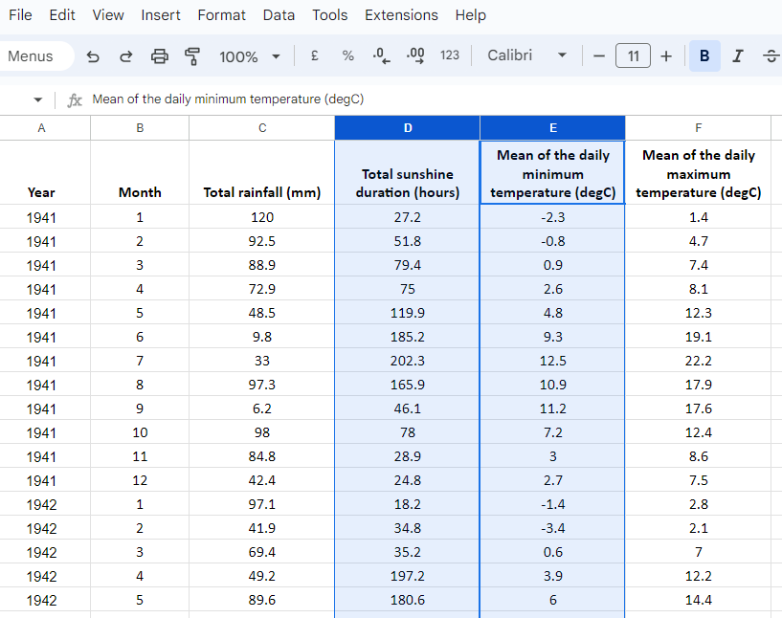
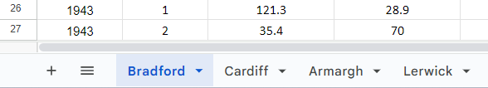
Constructing scatter graphs using Desmos
Plot a scatter graph to represent total sunshine duration and mean of the daily minimum temperature for Bradford.
In the spreadsheet:
make sure the Bradford tab is selected at the bottom of the screen
select the data columns as previously shown
copy the data by holding the ctrl key and pressing c
Google Sheets is a trademark of Google LLC and this content is not endorsed by or affiliated with Google in any way.

Slide 28
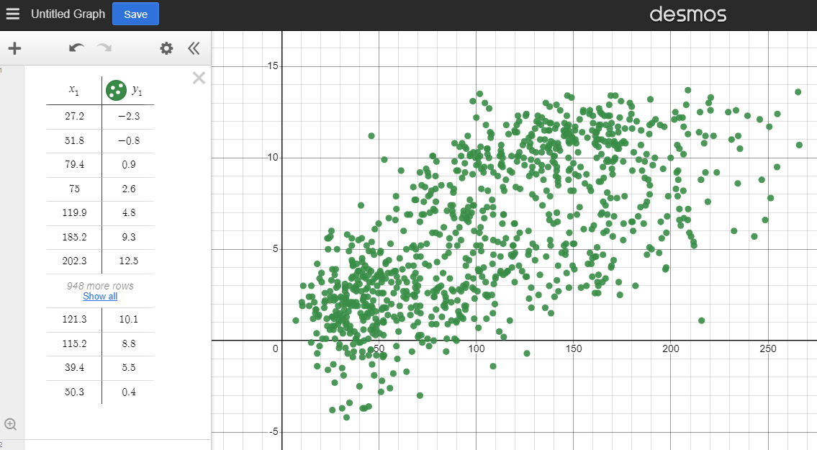
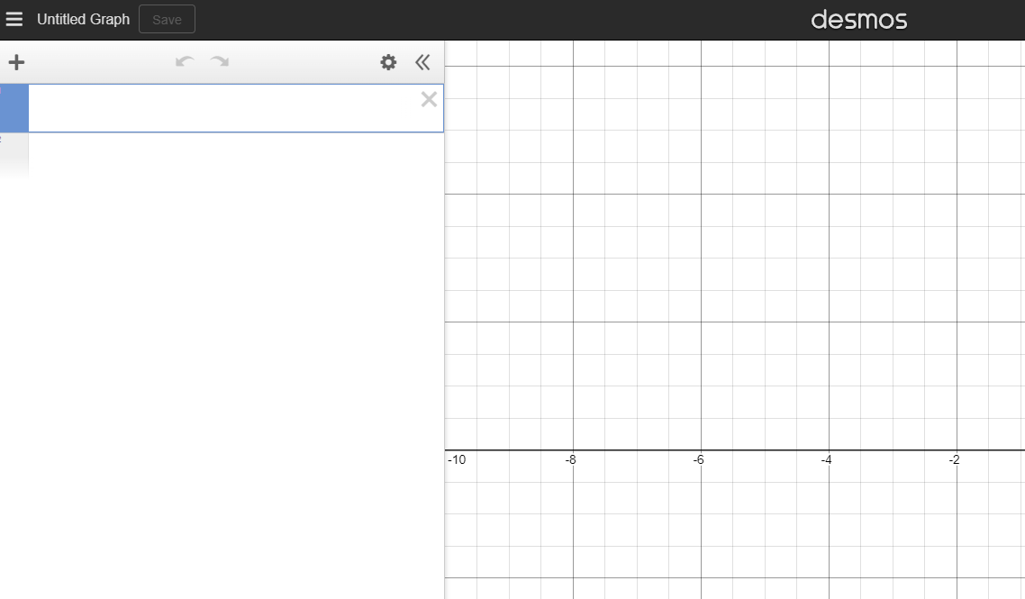
Constructing scatter graphs using Desmos
Plot a scatter graph to represent total sunshine duration and mean of the daily minimum temperature for Bradford.
In Desmos:
click the first open cell in the side panel
paste the data by holding the ctrl key and pressing v
Desmos automatically displays the data as a scatter graph.

Slide 29
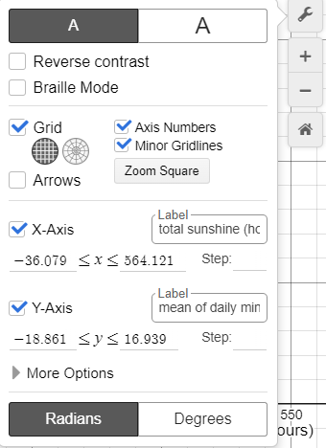
Constructing scatter graphs using Desmos
Plot a scatter graph to represent total sunshine duration and mean of the daily minimum temperature for Bradford.
To label the axis:
click spanner symbol in the top
right
corner
type in the label boxes for the x-axis and y-axis

Slide 30
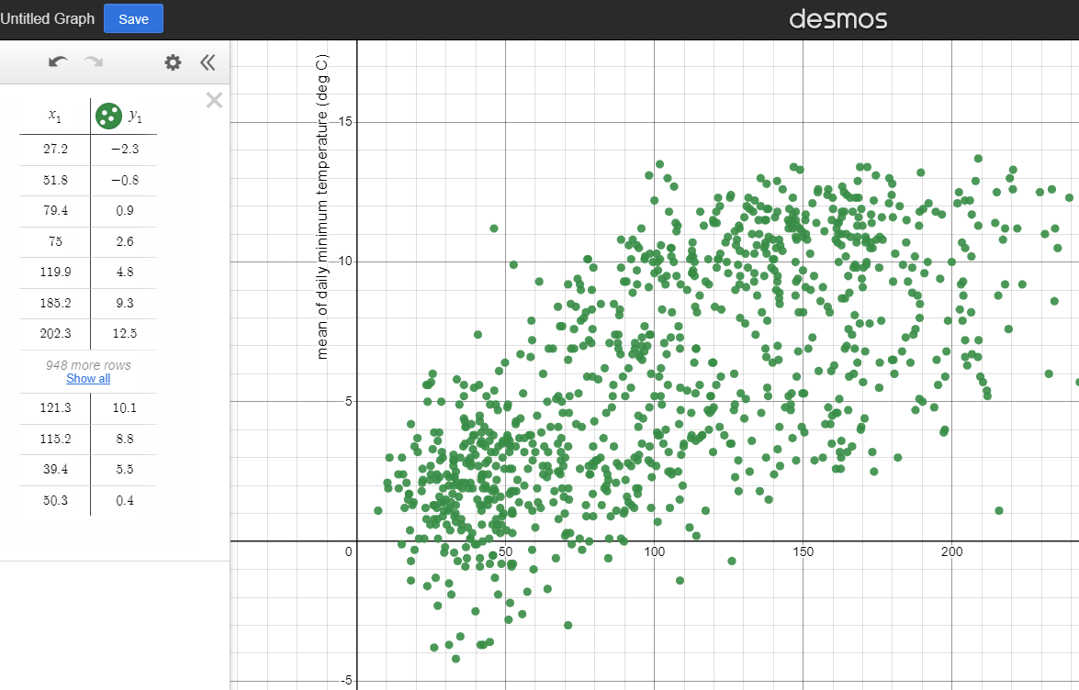

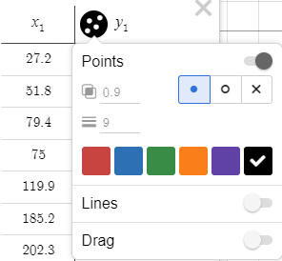

Constructing scatter graphs using Desmos
Plot a scatter graph to represent total sunshine duration and mean of the daily minimum temperature for Bradford.
To change the colour of the points:
click
and
hold
the
symbol
next to until an options box appears
select a colour for the points

Slide 31
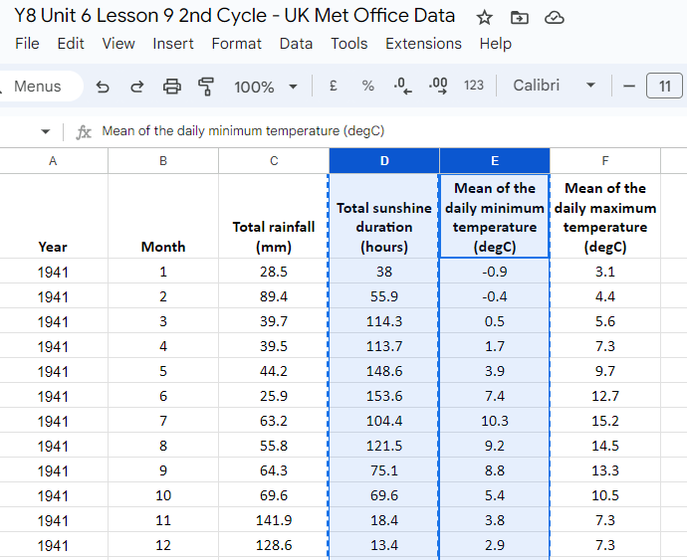
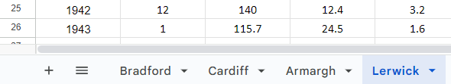
Constructing scatter graphs using Desmos
On the same graph, plot total sunshine duration and mean of the daily minimum temperature data for Lerwick.
In the spreadsheet:
make sure the Lerwick tab is selected at the bottom of the screen
highlight and copy the data as previously shown
Google Sheets is a trademark of Google LLC and this content is not endorsed by or affiliated with Google in any way.

Slide 32
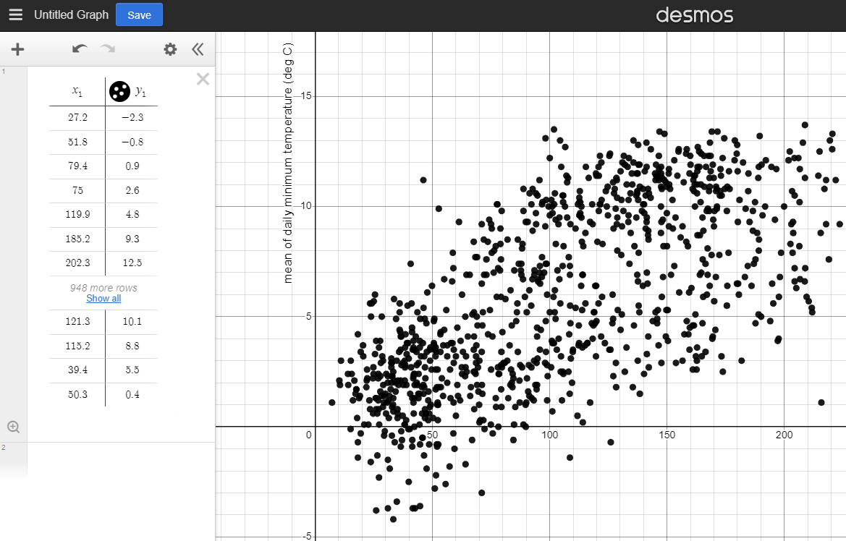
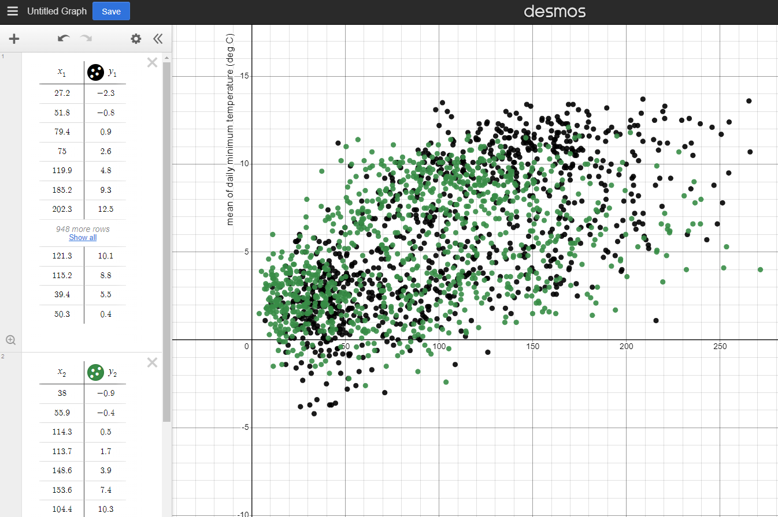
Constructing scatter graphs using Desmos
On the same graph, plot total sunshine duration and mean of the daily minimum temperature data for Lerwick.
In Desmos:
click the second open cell in the side panel
paste the data by holding the ctrl key and pressing v

Slide 33
Constructing scatter graphs using Desmos
How do you copy data, after the columns have been highlighted?
press ctrl and then press c
hold ctrl and press c
press ctrl and then press v
hold ctrl and press v

Slide 34
Constructing scatter graphs using Desmos
How do you paste data, after the columns have been highlighted?
press ctrl and then press c
hold ctrl and press c
press ctrl and then press v
hold ctrl and press v

Slide 35
Constructing scatter graphs using Desmos
After you paste bivariate data into Desmos, you need to then click ‘insert’ and ‘chart’ to plot a scatter graph.
Desmos plots a scatter graph automatically when you paste in the data.
You need to tell Desmos that you want to plot a chart with the data before choosing scatter graph.

Slide 36
Constructing scatter graphs using Desmos
1) Access the data for this task by clicking here: UK weather data🖇
Construct a scatter graph for Bradford’s data, with the horizontal axis showing total rainfall and the vertical axis showing total sunshine duration.
Google Sheets is a trademark of Google LLC and this content is not endorsed by or affiliated with Google in any way.

Slide 37
Constructing scatter graphs using Desmos
2) Access the data for this task by clicking here: UK weather data🖇
a) Construct a scatter graph for Armagh’s data, with the horizontal axis showing total sunshine duration and the vertical axis showing the mean of the daily maximum temperature.
b) On the same graph plot the same data for Lerwick and make sure the points are a different colour to Armagh’s data.
c) Which town tends to get the warmest?
Google Sheets is a trademark of Google LLC and this content is not endorsed by or affiliated with Google in any way.

Slide 38
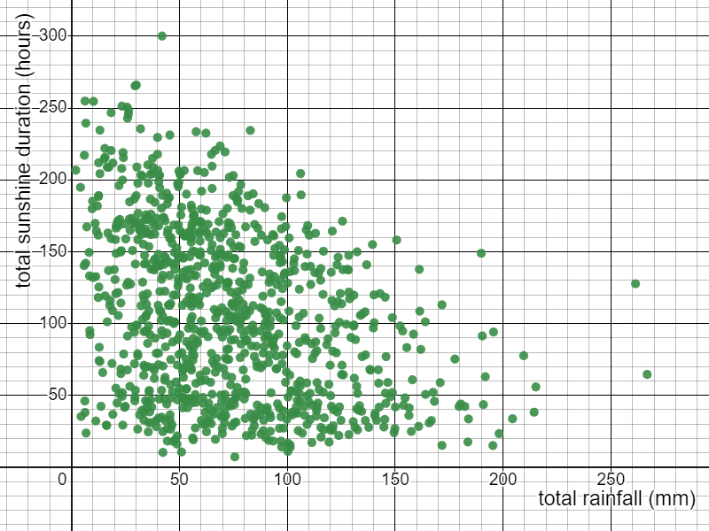
Constructing scatter graphs using Desmos
1) Access the data for this task by clicking here: UK weather data🖇
Construct a scatter graph for Bradford’s data, with the horizontal axis showing total rainfall and the vertical axis showing total sunshine duration.
Google Sheets is a trademark of Google LLC and this content is not endorsed by or affiliated with Google in any way.

Slide 39
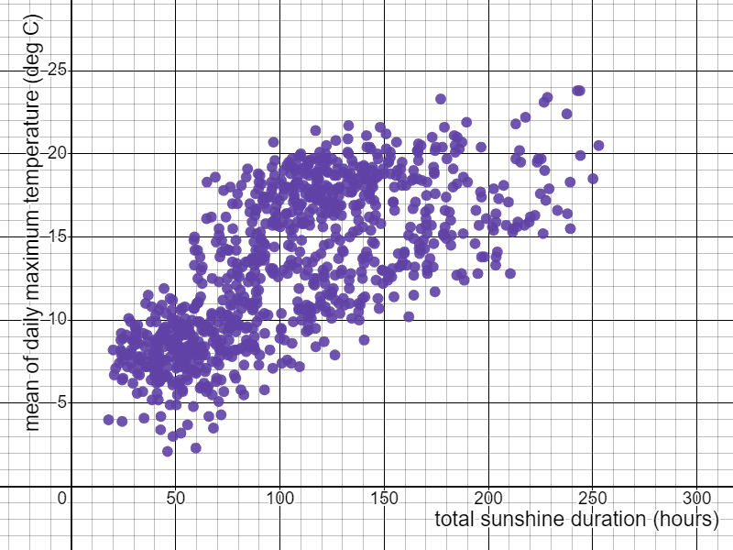
Constructing scatter graphs using Desmos
2) Access the data for this task by clicking here: UK weather data🖇
a) Construct a scatter graph for Armagh’s data, with the horizontal axis showing total sunshine duration and the vertical axis showing the mean of the daily maximum temperature.
Google Sheets is a trademark of Google LLC and this content is not endorsed by or affiliated with Google in any way.

Slide 40
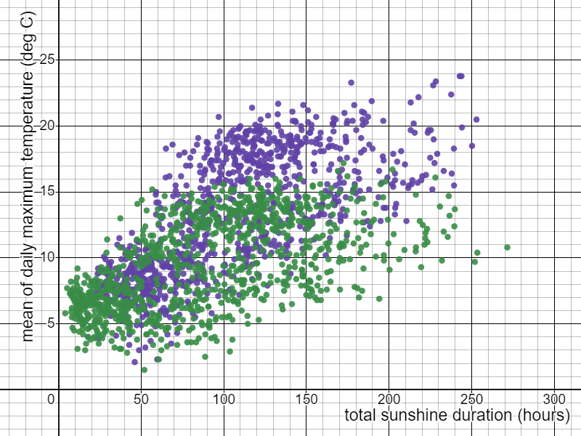
Constructing scatter graphs using Desmos
b) On the same graph plot the same data for Lerwick and make sure the points are a different colour to Armagh’s data.
c) Which town tends to get the warmest?
Amargh
Google Sheets is a trademark of Google LLC and this content is not endorsed by or affiliated with Google in any way.

Slide 41
Constructing scatter graphs by utilising technology
Scatter graphs can be constructed quickly using spreadsheets.
Scatter graphs can be constructed quickly using Desmos.
Changing which axis is used for which variable affects how the scatter graph appears.

Slide 42

© Oak National Academy 2023.
Produced in partnership with Mathematics in Education and Industry.
Licensed on the Open Government Licence v3.0, except where otherwise stated. See Oak terms and conditions.

